Slide 1


Expert Decision Replay Platform
Complete Implementation Specification & Architectural Overview
Enterprise Decision-Governance Platform

Slide 2
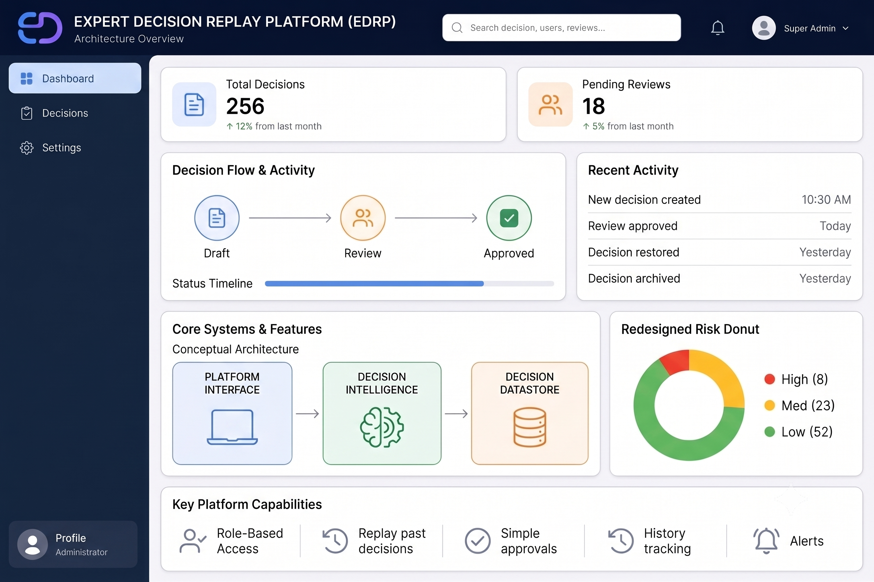

Executive Overview
The Platform: An enterprise application designed to track, analyze, audit, and replay organizational decision-making processes.
Prevents Knowledge Loss: Centralizes historical decision rationale, options considered, and formal meeting notes.
Structured Governance: Enforces automated approval workflows based on risk and category, eliminating informal chat-based decisions.
Accelerated Onboarding: New team members can review fully documented past choices, alternatives, and outcomes.

Slide 3
Architecture & Stack
Backend API (FastAPI): Python 3.11+ running on a Uvicorn server handling high-performance RESTful endpoints.
Database (PostgreSQL): Relational structured data managed via SQLAlchemy ORM with strict static type-checking.
Frontend UI (Flask + JS): Server-rendered UI integrated with interactive Vanilla JavaScript (decision.js).
Modern Styling: Glassmorphism UI utilizing custom Bootstrap 5, Lucide icons, and real-time polling logic.

Slide 4
Database Architecture (ERD)
Users Table: The central identity hub tracking authentication (`hashed_password`, `role`) and mapping platform-wide actions.
Decisions & Alternatives: The parent entity storing active state (`status`, `category`), directly linked to quantitative options (`cost`, `risk_level`).
Decision_Versions: An immutable tracking table. Every edit generates a new snapshot row to protect historical data.
Discussion_Messages: Features a self-referencing relationship (`parent_id`) to support deeply nested replies and threaded feedback.

Slide 5
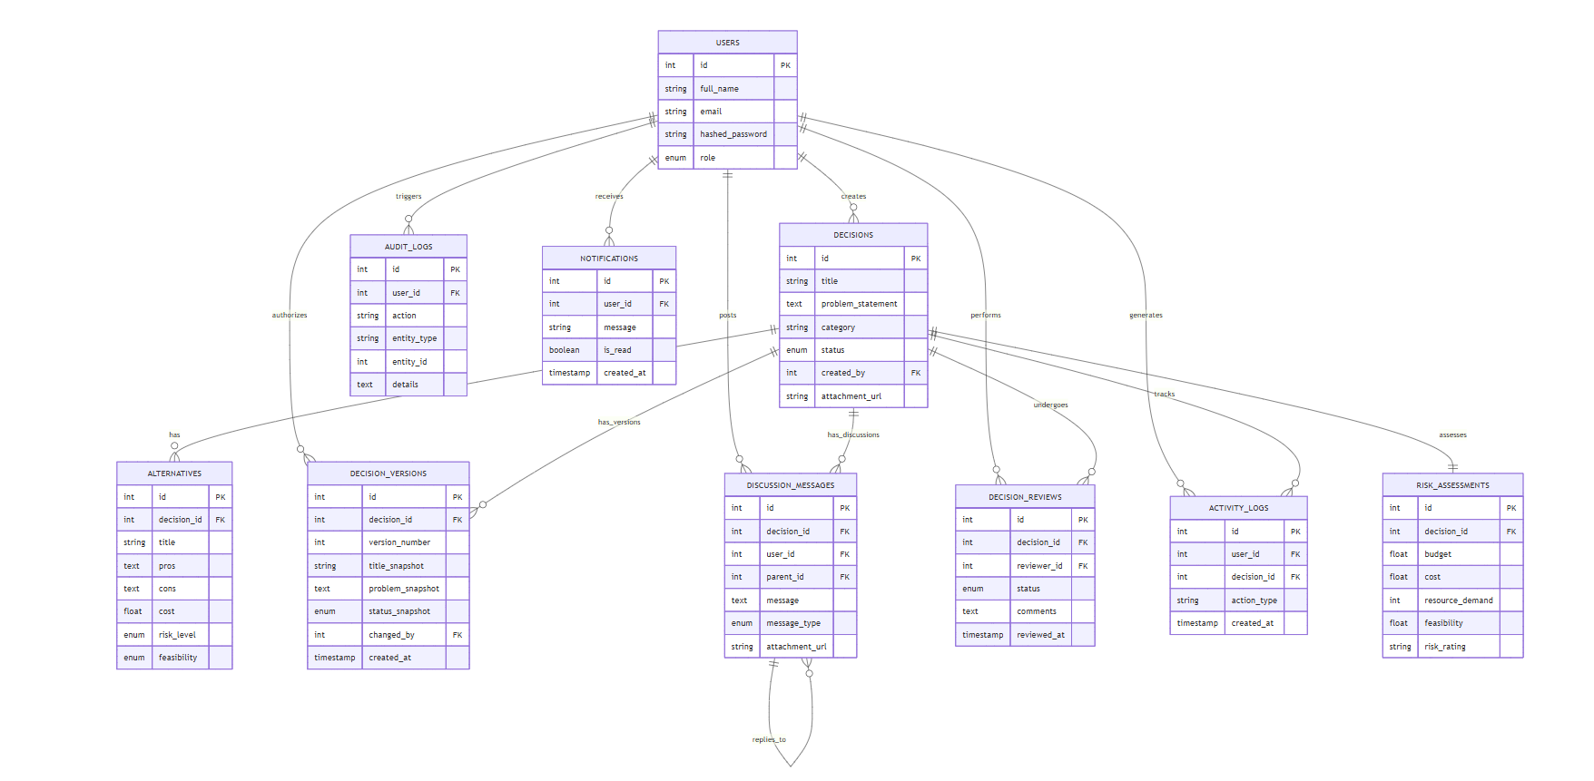
ER DIAGRAM

Slide 6





Implemented Modules
Automated Workflows
Dynamic Risk Engine
Multi-Role Dashboards
Intelligently routes decisions. E.g., High-budget items (>$500k) mandate sequential Finance approval; Tech items trigger parallel Engineering reviews.
Evaluates budget and resource demand during creation, auto-assigning Low, Medium, or High risk scores to flag complex decisions.
Distinct, dynamic views tailored for Employees (Drafts/Tasks), Reviewers (Pending Approvals), Managers (Team Metrics), and System Admins.

Slide 7
API Flow: File Uploads
Step-by-step breakdown of a user interaction:
Request: Flask frontend sends FormData (message, decision_id, file) to FastAPI endpoint.
Validation: Auth Middleware verifies JWT token and validates MIME type/file extension for security.
Storage: File is saved locally to `/uploads` with a unique UUID4 non-guessable filename.
Database: Inserts row into `Discussion_Messages` and generates an `AuditLog` entry.
Response: React/JS frontend appends comment dynamically upon receiving HTTP 200 OK.

Slide 8
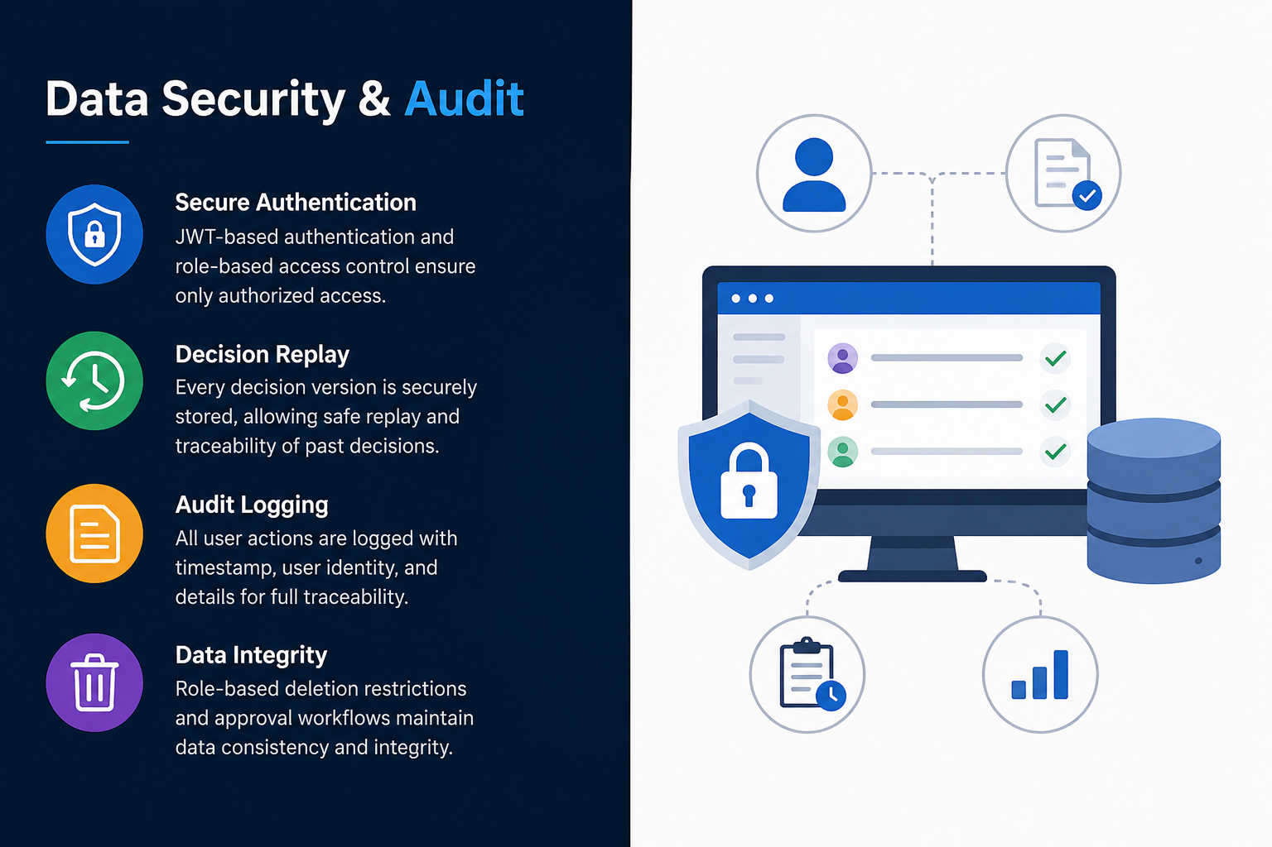
Data Security & Audit
Cryptographic Hashing: The system utilizes Python's `hashlib` to generate SHA-256 signatures, ensuring data authenticity and preventing DB tampering.
Decision Replay: Compliance officers can step backward/forward through snapshots to analyze the evolution of past choices.
Live Activity Logging: Replaced static data with real-time polling against the `ActivityLog` table. Displays dynamic sidebar badges for notifications.
Deletion Restrictions: Conditional locks prevent standard users from deleting 'Approved' or 'Rejected' records.

